Slide 1



Slide 2

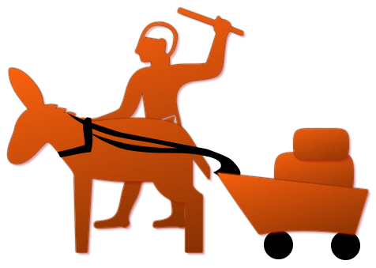
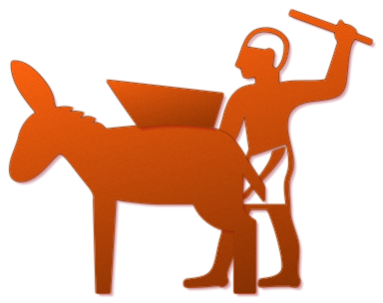
Evolution:

Slide 3
Our Objectives :
Action-Plan

Slide 4
Teach the people how to use the wheel and where to.
Increasing the Internal-demand.
Popularizing in other cultures.
Sustaining interest in the product by “”Innovations” (Yesterday was Steve Jobs B’day).

Slide 5
Methodologies :
The “How” part

Slide 6
To teach people how to use and where to use :
All : De-Alienate “Wheel”
Ferrying : Carrying heavy goods like seeds etc.
Farmers : Fetching water from streams
Potters : Usage in making strong pottery
Mills : Grinding grains , Flour, Seed - oil etc
Introduction of pulley for wells

Slide 7
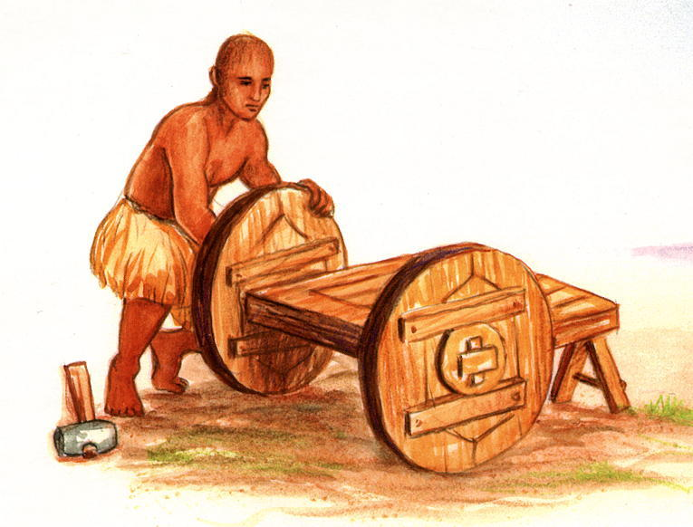

Slide 8
Increasing the Internal-demand:
Giving carts for rent
Toys for kids
“Pubic transport system” using bullocks
Casino : Fortune wheels

Slide 9
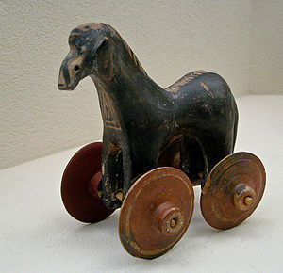
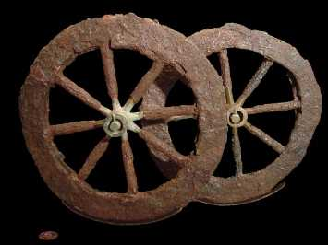
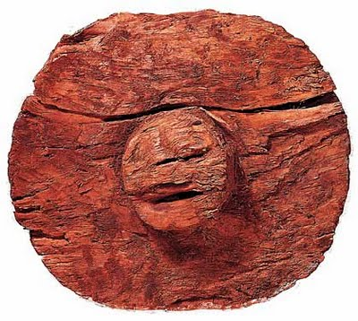

Slide 10
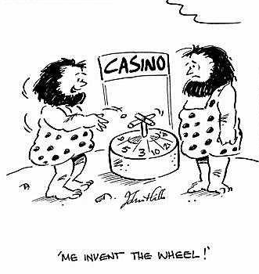
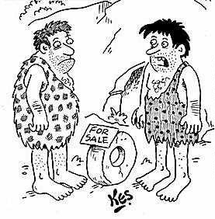
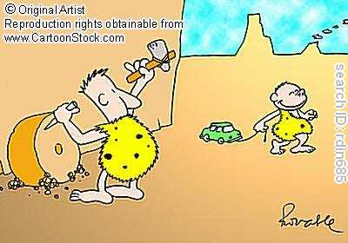
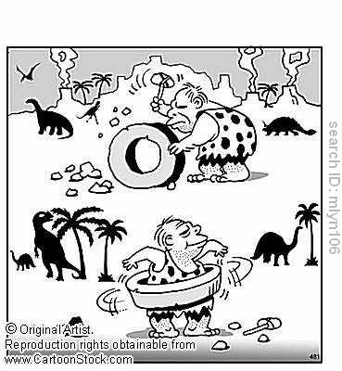

Slide 11
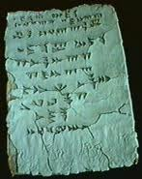
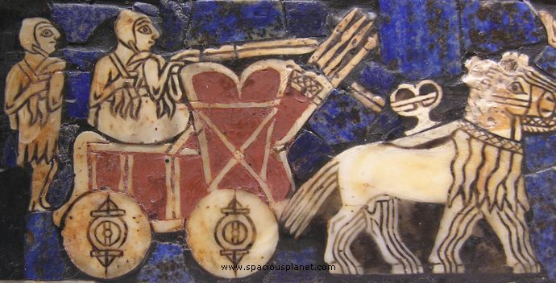
Publicity:
Contraptions : In market places
Stone carvings: In common places
Food items: In the shape of wheel
Street plays: @ Community centers
Traders: Popularizing among traders – giving animal driven carts
Animal cart races
Pamphlets : Diagrams describing use of wheels, on animal skin

Slide 12
Spreading to other cultures:
The cultures that existed then where
Susa (Iran since 7000 BC)
Uruk period (Sumer) ( we are URUK)
Naqada IIb (Ancient Egypt)
Early Minoan I
Sredny Stog culture (final phase)
Yamna culture (early phase)
Cucuteni culture
Vinča culture
Megalithic Europe (Atlantic fringe)
Comb Ceramic culture
Funnelbeaker culture
Yangshao culture

Slide 13
Civilization | Location | Prominent characterstics | Target areas
Yangshao culture | central Yellow River in China | Farming Pottery | Potter’s wheel Transport-animal cart Water wheel
Funnelbeaker culture | Germany | Pottery | Potter’s wheel Transport-animal cart
Comb Ceramic culture | Northeast Europe | Ceramics | Transport-animal cart
Vinča culture | South-eastern Europe | Agriculture, Animal husbandry Hunting and gathering | Water wheel Transport-animal cart
Yamna culture | Ukrainian | Pottery | Transport-animal cart
Naqada | west bank of the Nile | Painted pottery Metalworking Cylindrical jars | Transport-animal cart

Slide 14
Civilization | Location | Specialties | Target areas
Cucuteni-Trypillian culture | Romania- Ukraine- Russia | Salt-works Ceramics Weapons Textiles | Transport-animal cart War instruments
Minoan civilization | Crete | Warfare Architecture Agriculture Pottery | Water wheel Transport-animal cart War instruments Pottery wheel
Susa |  | Architecture Pottery | Transport-animal cart Pottery wheel

Slide 15
Trade was existent among a few of the above. We provide our traders with carts, thus carts are introduced in their cultures : Using barter system for selling the traders there ,carts by our “Executives”.
Every culture has a specialty.
For example : First zoo was opened in Nekhen (Hierakonpolis) - we provide rolling gates for them, mobile cages for transport of animals.
International cart races

Slide 16
Innovations:
Invention of “Water turbines” for seed mills
Invention of axle
Invention of wind mills for drawing water especially in deserts

Slide 17


